Slide 1
Social Construction of Technology

Slide 2
Wiebe E. Bijker Emeritus Professor in Maastricht University, The Netherlands.
Bijker formulated in 1983 the ‘social construction of technology’ (SCOT) heuristics and theory.
In 2006 Bijker received the John Desmond Bernal Prize jointly awarded by the Society for Social Studies of Science and the Thomson Scientific for his distinguished contribution to the field of science and technology studies.
In 2012 he was awarded the Leonardo da Vinci Medal by the Society for the History of Technology for his contribution to the history of technology.
He has contributed to constructivist accounts of studying science and technology through the approach of Social Construction Of Technology (SCOT).

Slide 3
The Social Construction Of Technology (SCOT) according to Bijker is one among other accounts of studying scientific facts and technical artefacts in the 1980s.
Acc. to him, SCOT denotes two things:-
1.) It is a research approach that studies technical change in the society both in the historical and contemporaneous studies.
2.) It is a theory that studies development of technology and its relation to society.
Berger and Luckmann (1966) used the term ‘social construction’ for the first time suggesting that reality is socially constructed and these social processes should be the object of sociology of knowledge.
Acc. to Bijker, constructivist studies in science and technology come in wide variety. They are:-
a.) Mild version – “stress the importance of including the social context when describing the context of science and technology” (p.88).
b.) Radical version – argue that the truth of scientific statements and technical workings are constituted in social processes and can not be explained as just being derived from nature or as natural occurrences.

Slide 4
Acc. to Bijker, SCOT emerged out of three distinct bodies of work:-
1.)The science-technology-society (STS) movement
2.) The sociology of scientific knowledge(SSK)
3.) History of technology
STS movement began in 1970s in the Netherlands, Scandinavia, the United Kingdom and the United States. It was mostly targeted at Universities and secondary schools where issues of scientists’ social responsibilities, risk of nuclear energy, environmental pollution were discussed.
SSK began in late1970s in UK building up on works from sociology of knowledge, philosophy of science and sociology of science.

Slide 5
The history of technology began mostly in US where scholars began to raise more theoretical and sociologically relevant questions.
Acc. to Bijker, the starting point of SCOT was in 1984 when scholars from these three tradition attended an international conference in the Netherlands.
The volume from that conference was published as a book edited by Bijker, Hughes, and Pinch (1987) “The Social Construction of Technological Systems: New Directions in the Sociology and History of Technology”.
Acc. to Bijker, SCOT started as a criticism to the technological determinism (technology determines everything).
Acc. to Bijker, technological determinism comprised of ideas that:-
a.) technology develops autonomously without any relation to society or societal influence.
b.) technology determines to a great extent societal development.

Slide 6
Acc. to Bijker, technological determinism leads to only one dimensional view of technology development where social and political intervention in technological development are seen as impossible.
Acc. to Bijker, this view could only be criticised and wronged by bringing in social factors as shaping technological development.
Acc. to Bijker, initially the unit of analysis through SCOT was a single technical artefact then the field also included sociotechnical ensemble.
Acc. to Bijker, SCOT can be used to study technology in society by following three consecutive steps:-
Identify relevant social groups and their interpretative flexibilities:-
Acc. to Bijker, an artefact can be described through a relevant social group. A group becomes socially relevant if only it contributes in describing the artefact.
For example: If one is studying a bicycle (artefact) then the relevant social groups are bicycle producers (who give production meaning to the bicycle), users (who provide its usefulness or uselessness), anti-cyclist (who view bicycle different from the other two groups), etc.
These descriptions and meaning given to the artefact produces different meanings and interpretation of the same bicycle. These accounts taken together provides ‘interpretative flexibility’ to the researcher where the same artefact resembles as if many artefacts.

Slide 7
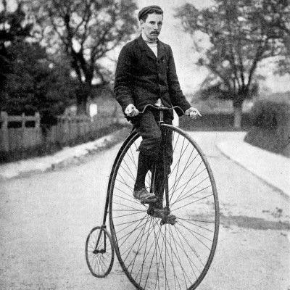
Bijker, studied evolution of bicycles in 1987 and gives an example of interpretative flexibility.
Acc. to him, in 1870s the ordinary bicycle was viewed by women cyclist as unsafe machines (as it entangled their skirts while riding them), whereas for ordinary users (male) it was a macho machine (as riding it was difficult and seen as a status of bravery and to impress women).
Picture 1: Source : https://i.pinimg.com/originals/7e/31/93/7e319356549d95d0190f09ecdfee237e.jpg accessed on 10th August 2017.
The Picture 1 represents the bicycle in 1870s where the front tyre was much bigger than the back tyre which required strength to hop on the bicycle and ride it.

Slide 8
Acc. to Bijker, the second step to study technology is by:-
2. Identifying how the interpretative flexibility diminishes-
Acc. to Bijker, when relevant social groups describe the artefact they bring in different interpretations to the artefact. These different interpretations point to different problems with the artefact. The stabilisation of these problems bring in closure in the debate about the artefact. Acc. to Bijker, these two concepts are meant to bring in the process of social construction in the different line of development of the artefact.
For example: Bijker showed in his study of bicycle how elderly men and women did not regard the bicycle of 1870s as safe to ride. These interpretation gave rise to “lowering of the front wheel, moving back the saddle and giving the front fork a less upright position” (Pinch and Bijker, 1989: 43).
The relation between one social group and the perceived problem gives rise to different solutions to that problem. Closure is brought when solution to the problem is materialised for that same group.

Slide 9
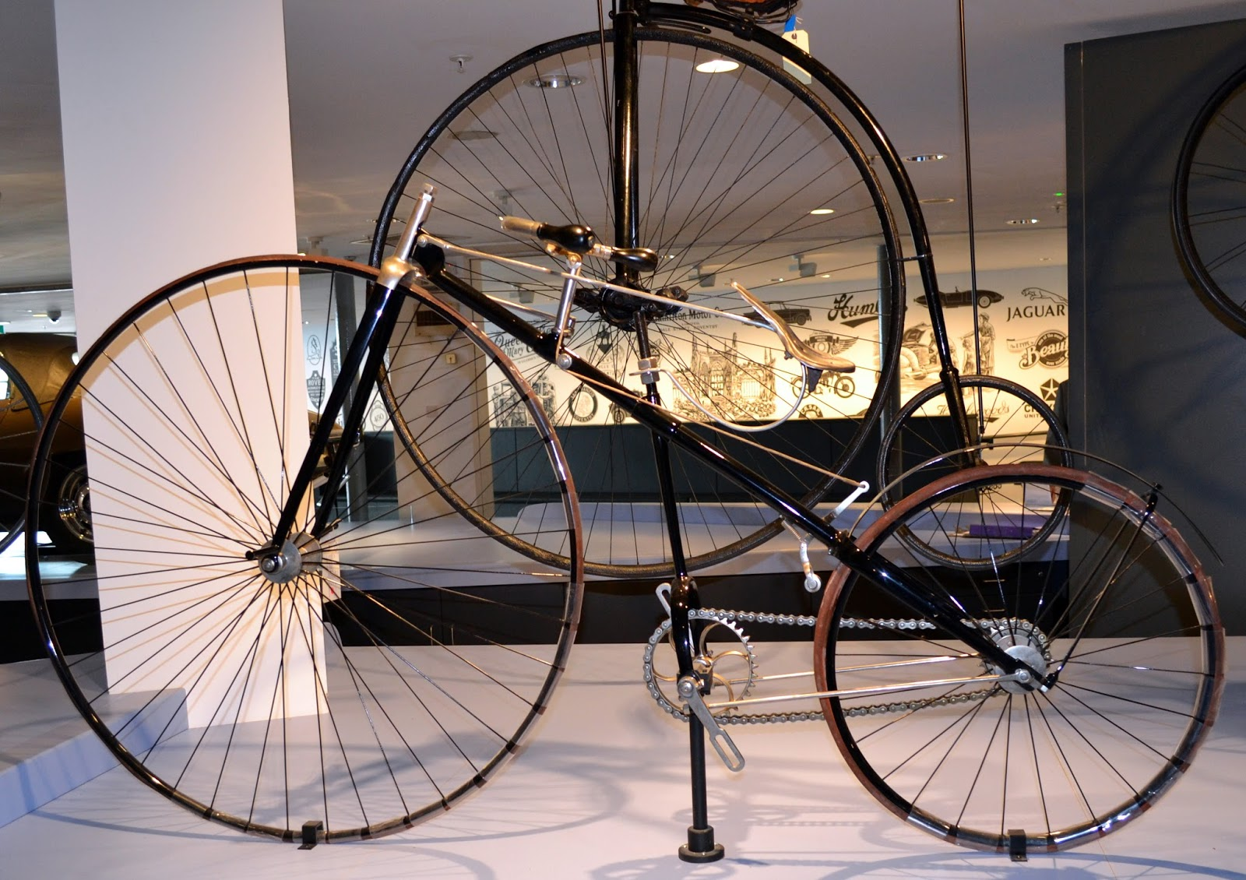
Picture 2- This picture represents the bicycle with lower front wheel (in the front) and the bicycle of 1870s (in the back).
Source:http://1.bp.blogspot.com/Uzt1WydiUko/Vbuyphki43I/AAAAAAAARrI/wgeXtiloj3M/s1600/front%2Blawson%2Bback%2Brudge.jpg accessed on 10th August 2017.

Slide 10
Acc. to Bijker, the third step to study technology is by:-
3. Technological frame-
Acc. to Bijker, the processes that go on in bringing in the stabilisation should be analysed and explained in this stage. For this he suggests to use ‘technological frame’ as a concept. Technological frame “structures the interactions among the members of a relevant social group, and shapes their thinking and acting”(p.91).
For example: Bijker suggests that scholars in this stage should look at explanation of the stabilisation process in a broader theoretical framework. Here scholars should ask the question why the social construction of the artefact followed a definite way than the other possible ways.
Here Bijker suggested to look at the sociocultural and political situation of the relevant social group which in turn might have influenced their description and meaning they add to the artefact. Thus, he suggests that norms and values which a social group adheres to might also shape their understanding of the artefact.
Acc. to Bijker these steps result in :-
Sociological deconstruction of the artefact
Description of the social construction of the artefact
Explanation of the social construction process through technological frames

Slide 11
Bijker and Pinch (1984) through their SCOT approach suggest that scholars of Science, Technology and Society should look at how actors define a problem as technical or scientific.
SCOT also provides scope for ethical enquiry of technical artefacts as it provides an idea that “things could have been otherwise” (p.92).
SCOT provides scholars the option to look at the hidden political dimensions of technical artefacts.
SCOT suggests that “Technology is socially (and politically constructed); society (including politics) is technically built; technological culture consists of sociotechnical ensembles” (p.92).

Slide 12
SCOT gives equal power to different social relevant group as having some form of expertise in giving a meaning to the artefact. Here prior knowledge in some field (scientists, engineers, etc.) does not give a social group superiority above others (women cyclists, elderly men, etc.)
SCOT also provides scope for religious values to be considered as a technological frame for certain social group. For Bijker and Pinch, some artefacts might need scholars to establish relation between religion and technology. Thus, interpretative flexibility can help scholars to distinguish between what is religious and what is not-religious interpretation.

